Slide 1

INF2011S Project
Sihle Calana and Ahmed Khan

Slide 2
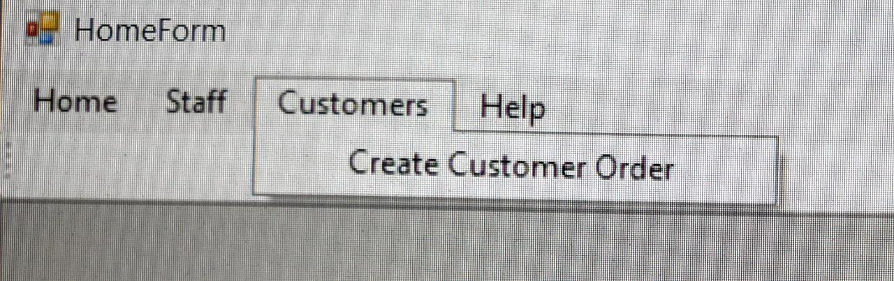

Main form

Slide 3
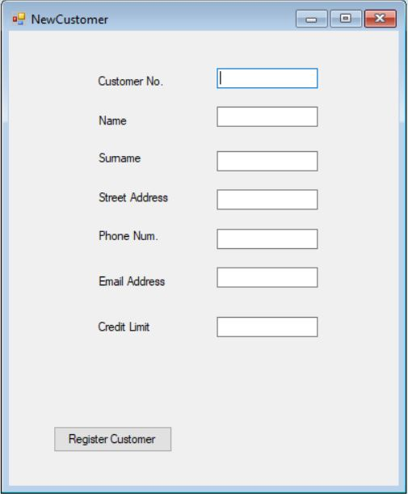
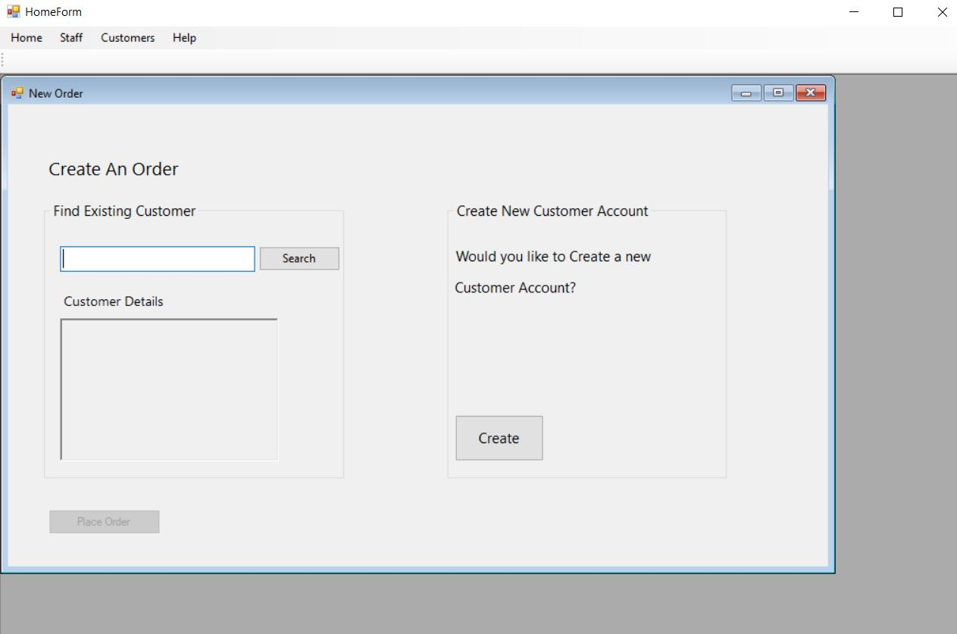
Create an Order

Slide 4
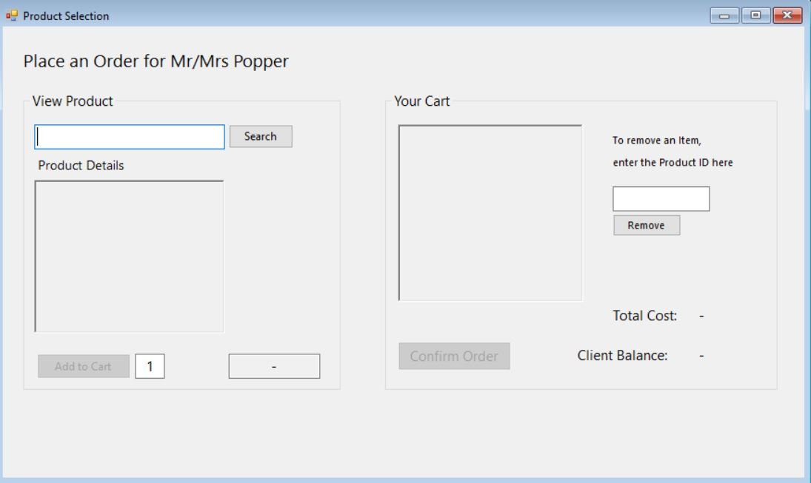
Product selection

Slide 5
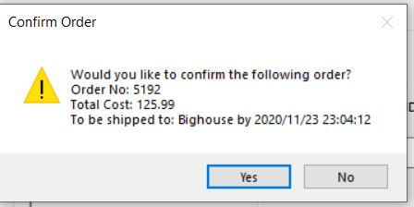
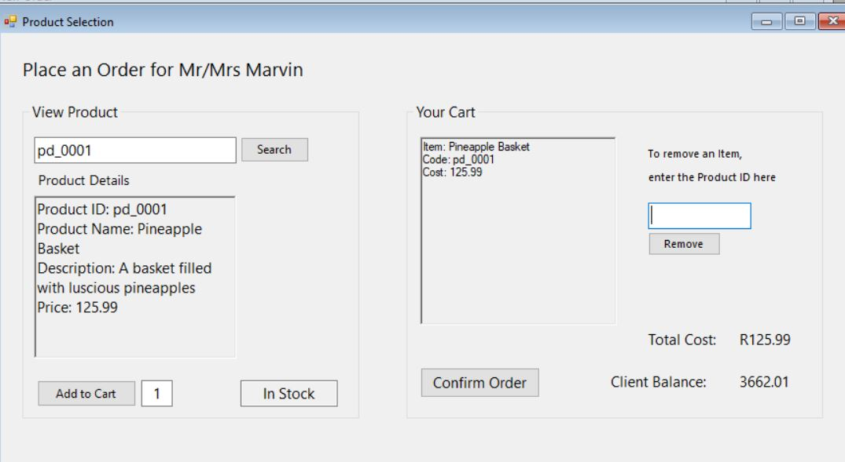
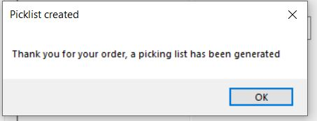
Order confirmation

Slide 6
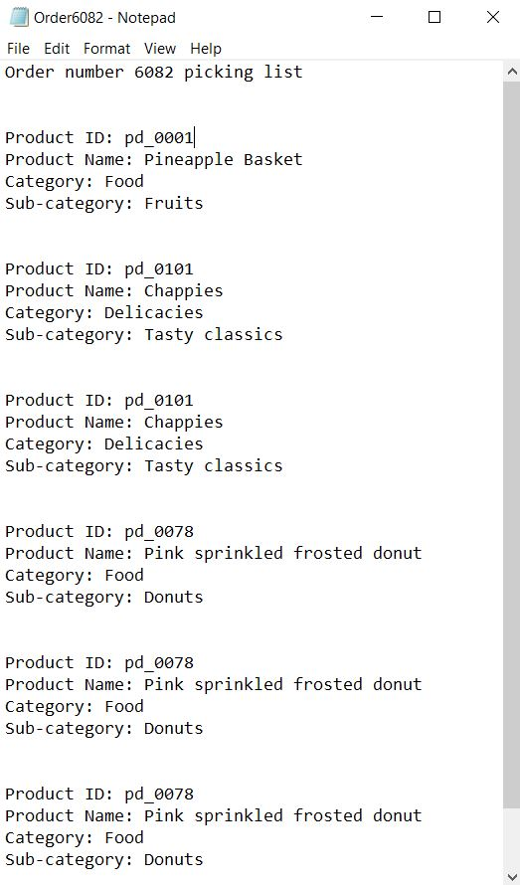
Picking list
Generation

Slide 7
TEST CASES
Order capture for unregistered customers (not in the Database)
Order capture for invalid customer ID input
Order capture for customers sanctioned Customers.
Order acceptance if the credit limit will be exceeded.
A product is out of stock
Insufficient stock to fulfill client order request

Slide 8
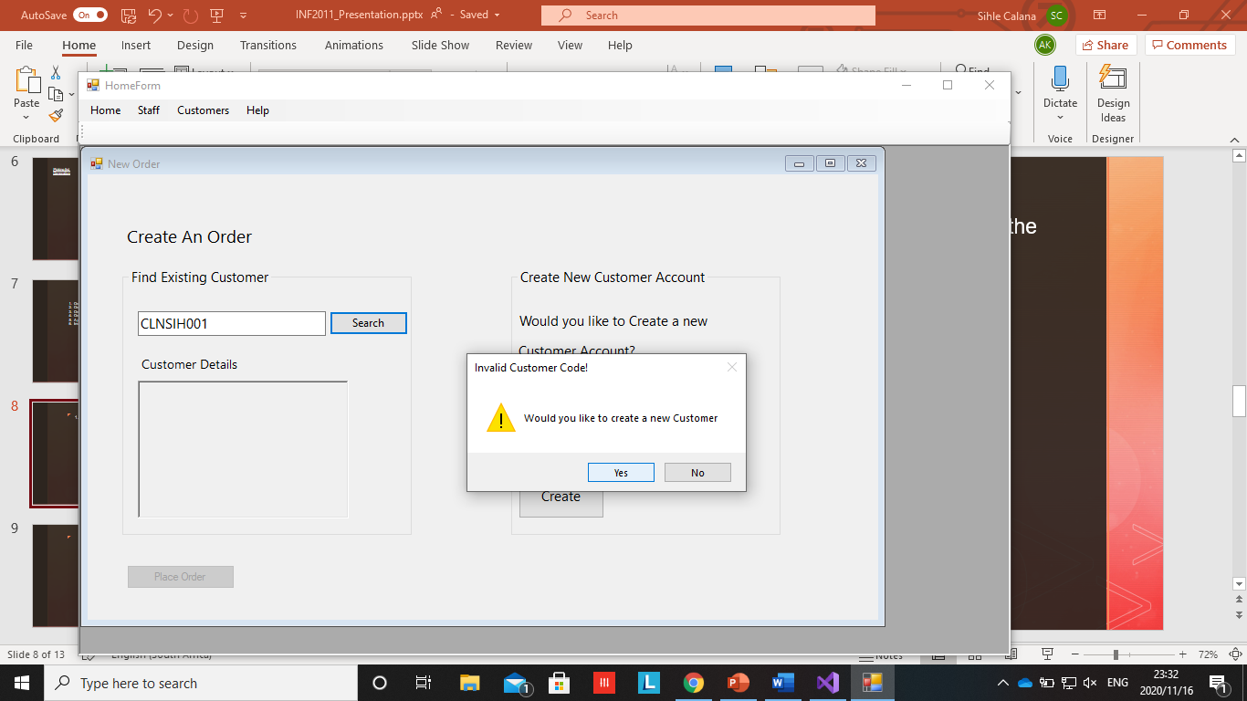

Order capture for unregistered customers (not in the Database)

Slide 9
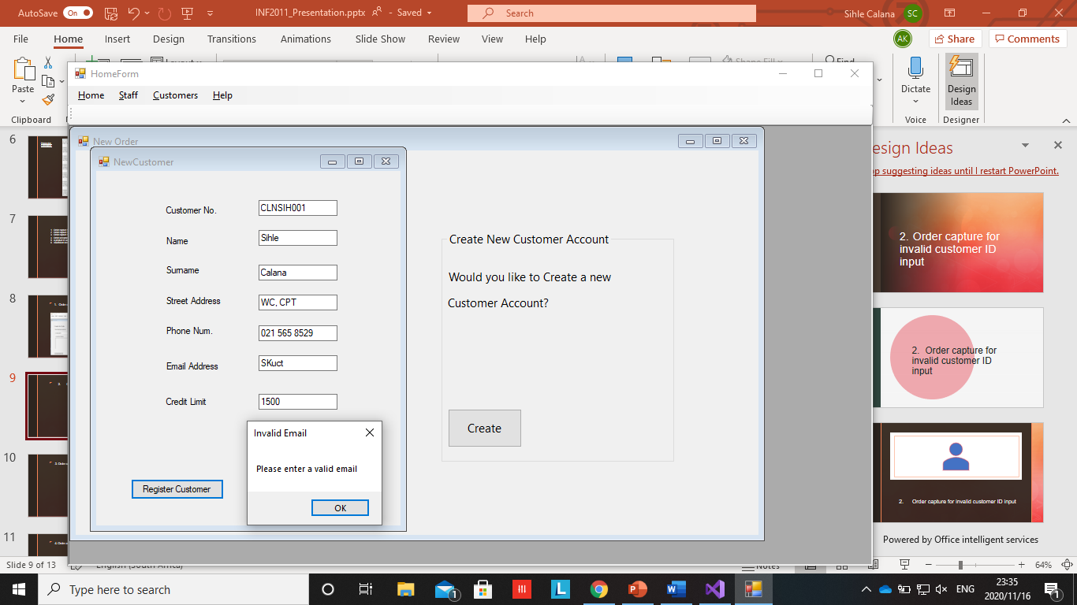
2. Order capture for invalid customer ID input

Slide 10
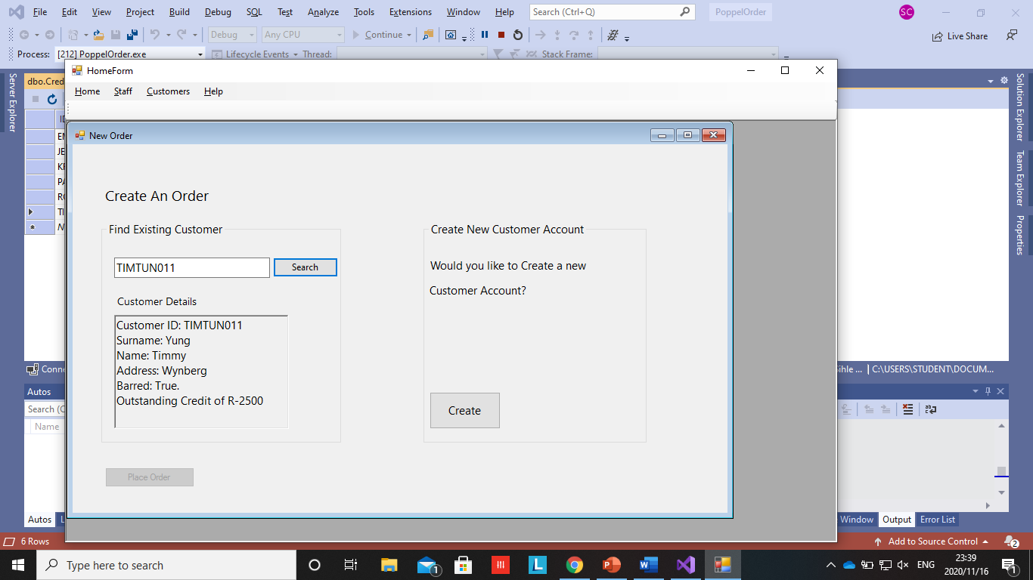
3. Order capture for customers sanctioned Customers.

Slide 11
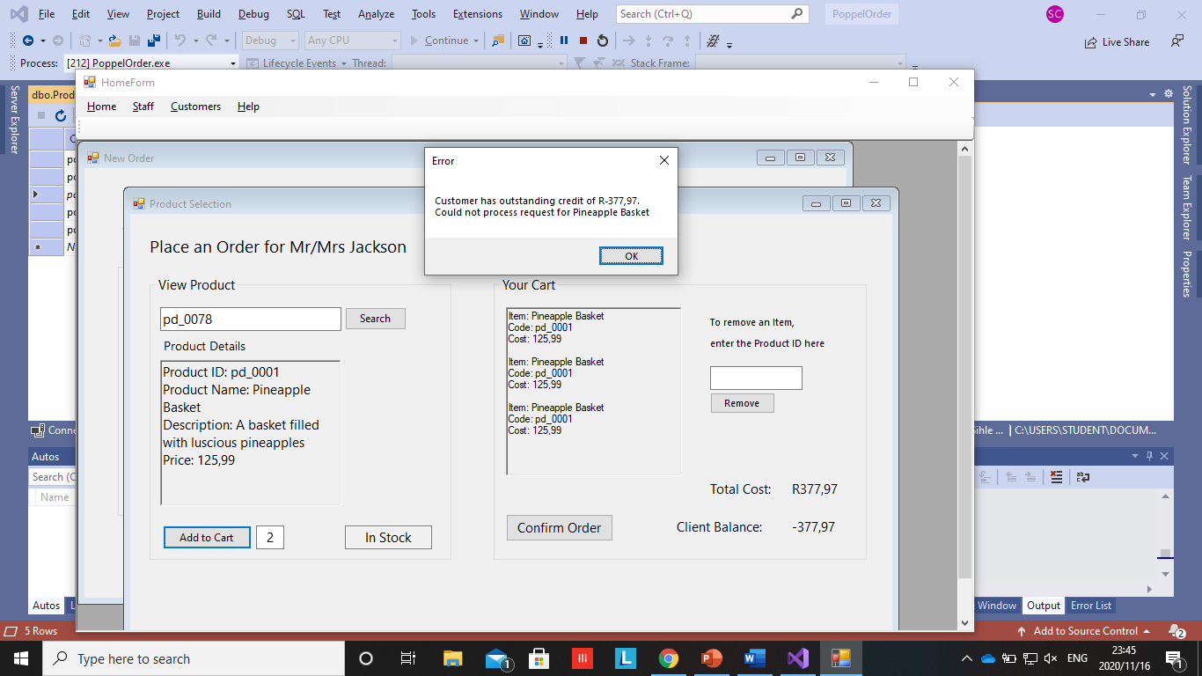
4. Order acceptance if the credit limit will be exceeded.

Slide 12
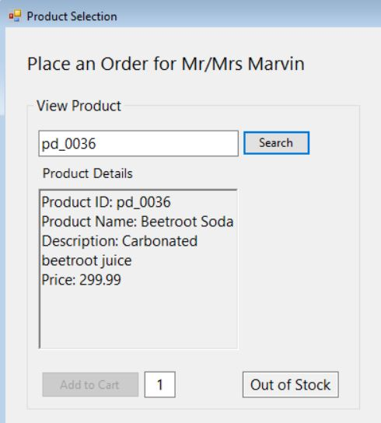
5. Order confirmation when the product is out of stock

Slide 13
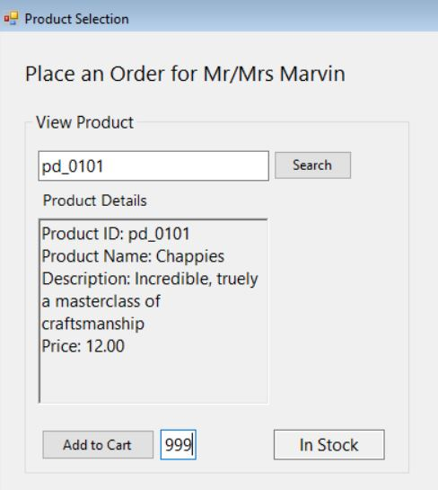
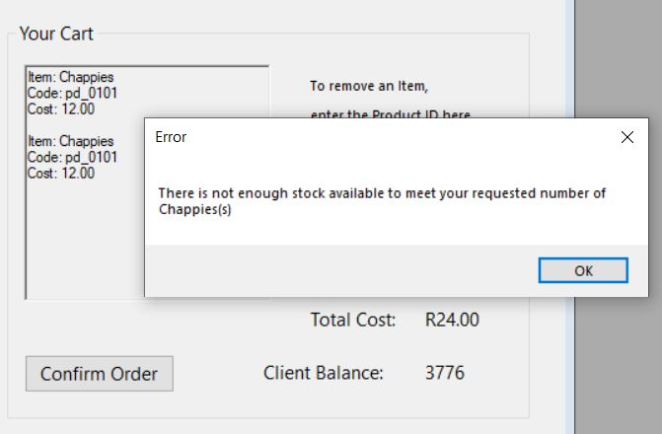
6. Insufficient stock to fulfill client order request

